Slide 1
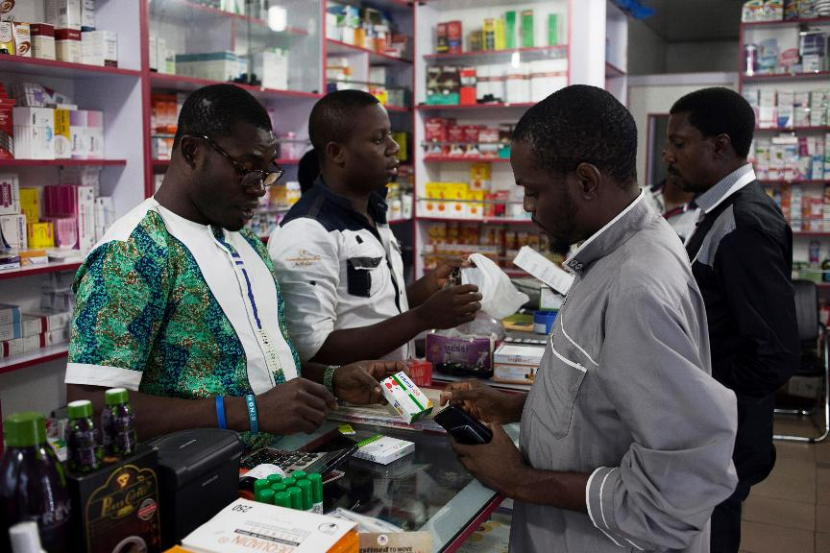

[COUNTRY, YEAR]
Module 3: Rapid diagnostic test (RDT) product audits

Slide 2
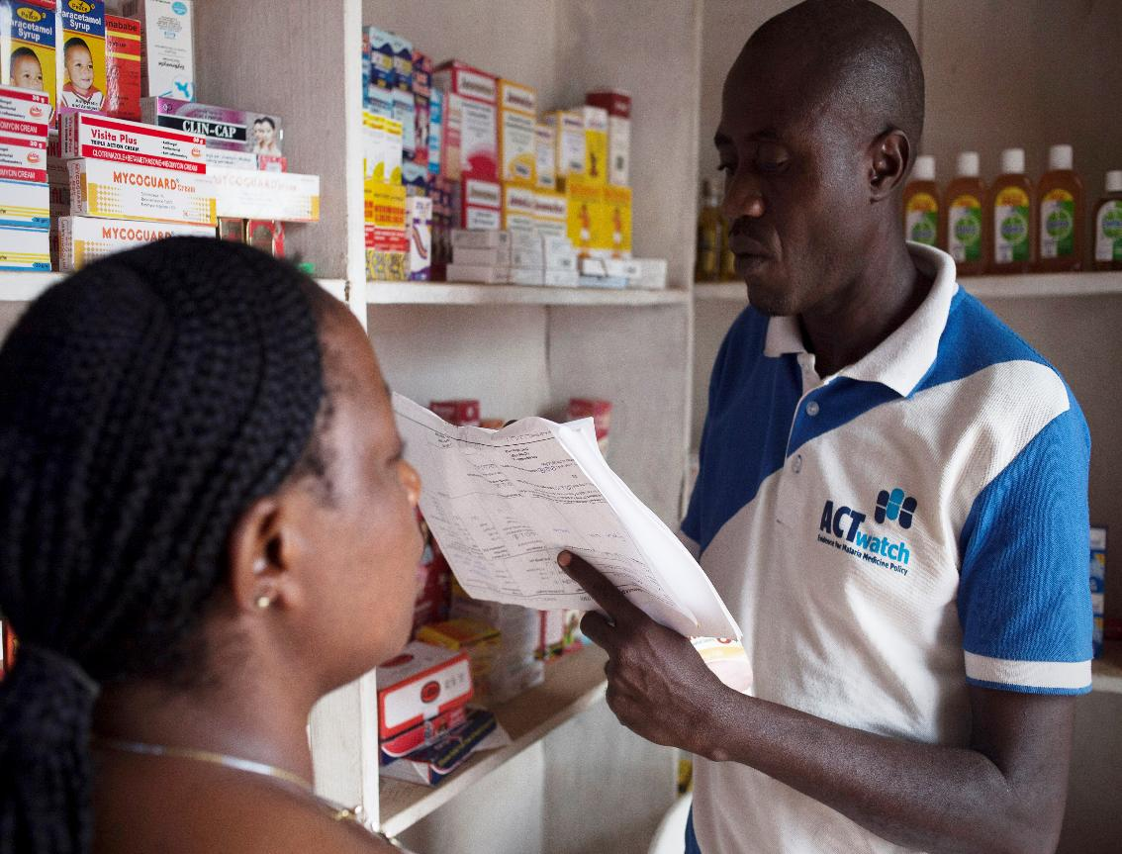
Agenda
3.1 RDT intro
3.2 Brand names and manufactures
3.3 Antigens and parasites
Notes:
1.8. Generic and brand names and main classes of antimalarial drugs
1.9. Form and dosage
2.2. Pack size
2.3 Quantity sold and stock outs
2.4. Retail and wholesale prices

Slide 3
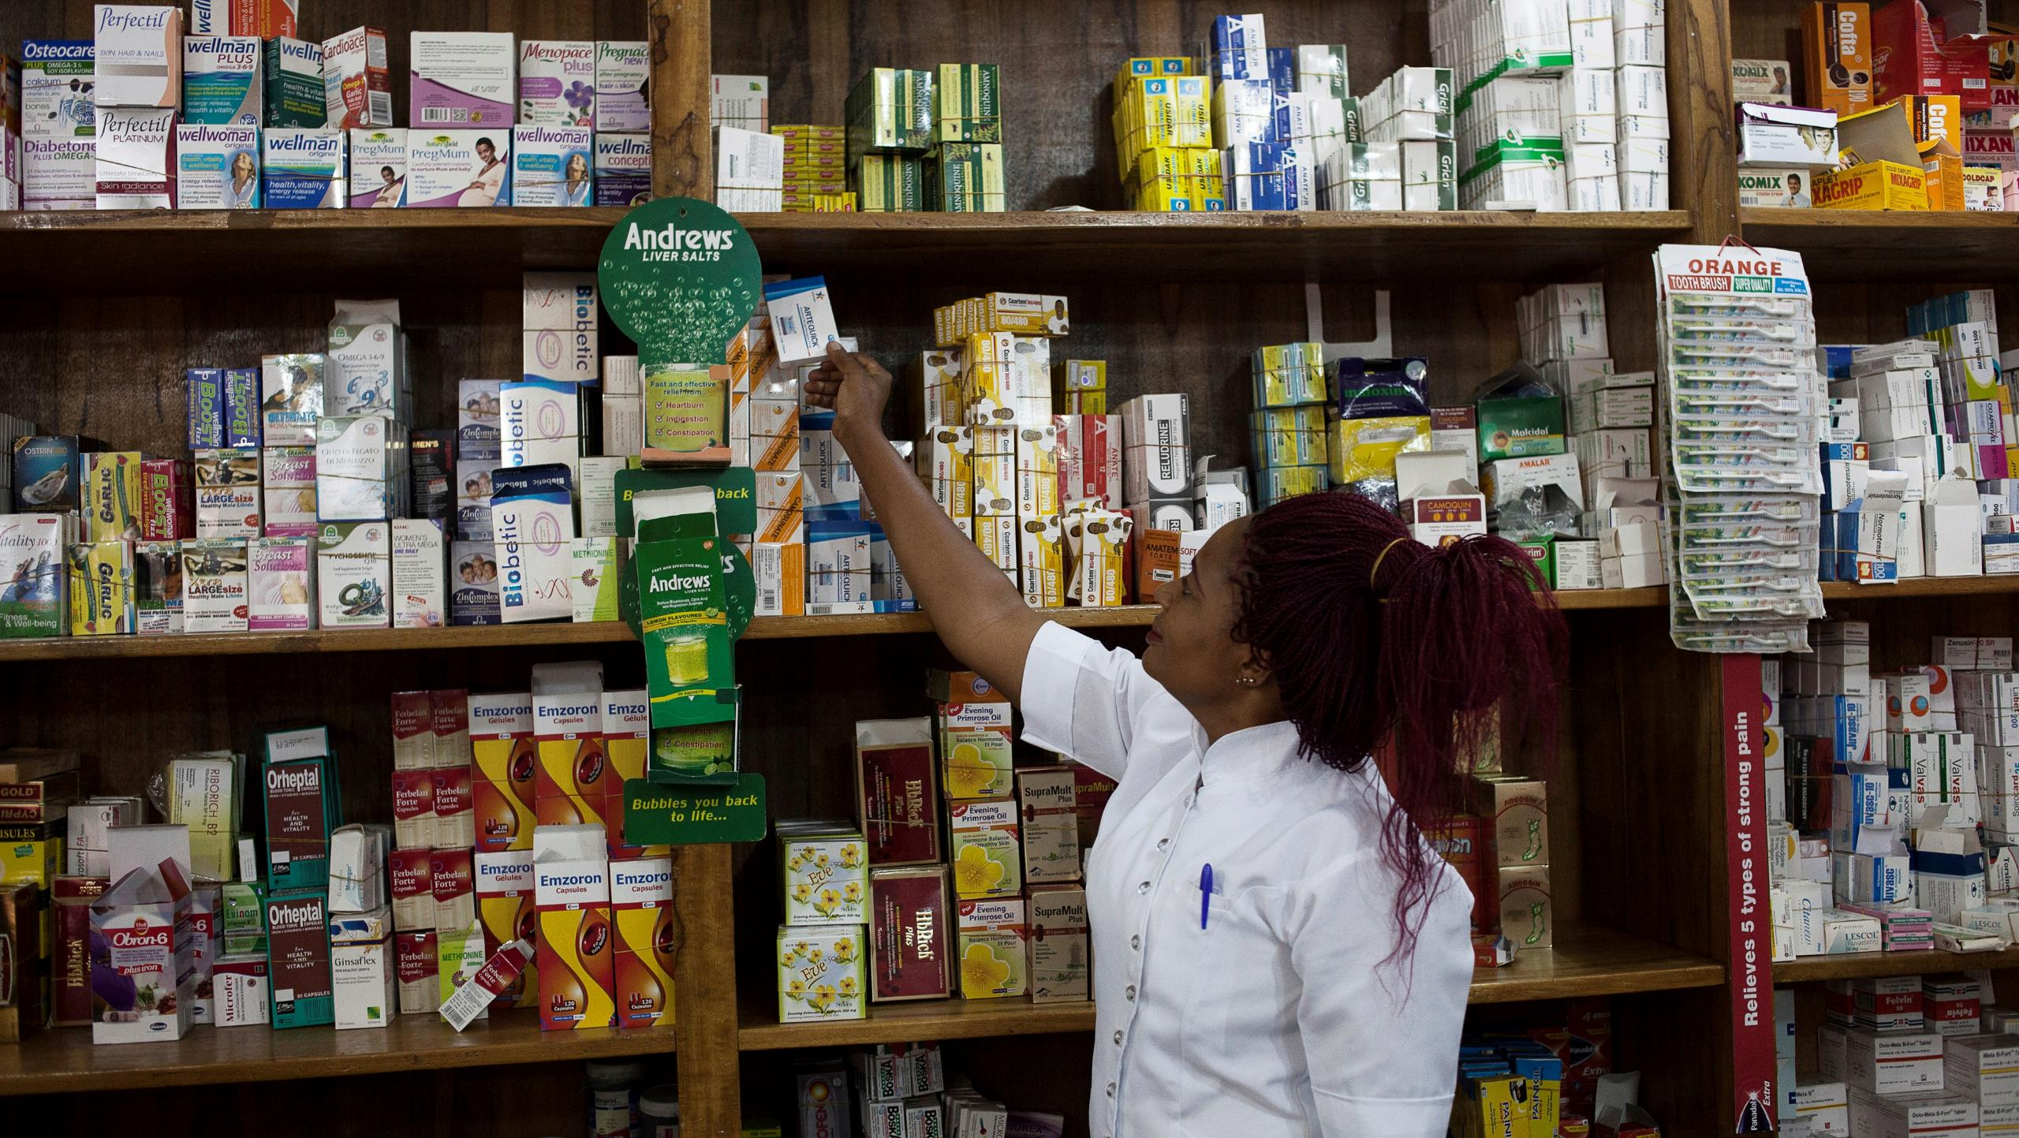
3.1 What is an RDT?

Slide 4
TRAINER NOTES
Objective:
Enable data collectors to recognize RDTs and correctly complete the audit sheet, including: brand, antigen, parasite, manufacturer, stock, price, and packaging.
Prompts & Answers:
What is an RDT? ➔ A rapid test for malaria using a small blood sample; result in ~15–20 minutes.
What are the information to collect for RDTs? - Brand name (e.g., First Response), - Parasite type (e.g., Pf, Pf/Pv, Pan), - Antigen detected (e.g., HRP2, pLDH), - Manufacturer & country, - Quantity sold in last 7 days, stockout in 3 months, price (in-house/take-away)
How to record in-house vs. take-away prices? ➔ In-house = test + consultation;
➔ Take-away = RDT only

Slide 5
Main Objective: To be able to fill in the RDT audit form correctly
At the end of this presentation, you should be able to:
Recognize a rapid diagnostic test
Complete all sections of the RDT audit form on paper

Slide 6
Malaria diagnosis
The last time you had malaria, what did you do?
In 2010, the WHO recommended:
"Parasitological confirmation by microscopy or alternatively by a rapid diagnostic test (RDT) ... for all patients suspected of having malaria before treatment is instituted.«
Malaria diagnosis is most often done using microscopy or rapid diagnostic tests (RDTs).

Slide 7
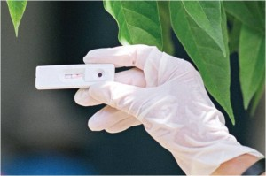
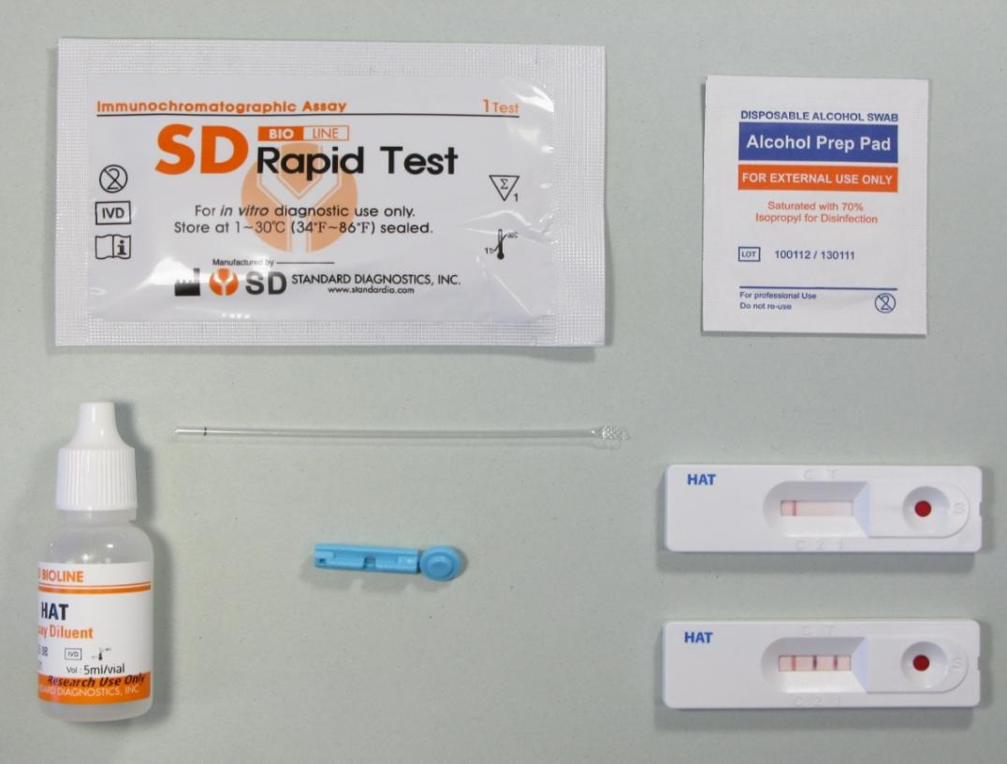
What is an RDT?
RDTs are small test kits that can detect malaria parasites in a blood sample.
They are accurate, simple, fast and inexpensive for confirming whether a person has malaria or not.
Results take approximately 15 to 20 minutes.
If RDTs detect malaria in a blood sample, a line appears in the the test window.

Slide 8
RDT Audit Form
Brand name: | Parasite specie(s): 1 Pf 2 Pf/Pan 4 Pf/Pv 5 Pan 8 Not indicated 96 Other; Specify | Antigen test(s): 1 HRP2 2 pLDH 3 HRP2/pLDH 4 HRP2/Aldolase 8 Not indicated 96 Other; Specify |  | Manufacture Name: Country: | Is this a self-administration test kit with its buffer, pipette and lancet? 1 = Yes 0 = No 8 = Don’t know
Quantity sold in the last 7 days : [___|___|___|___] [brand name] tests |  |  | Stocked out in last 3 months? 1 = Yes 0 = No 8 = Don’t know
In-house testing price to retail customers: Total cost for a test conducted with a [brand name] RDT (including RDT cost and service fee) for: Adult: [___|___|___|___|___]₦ to the last retail customer Child: [___|___|___|___|___]₦ to the last retail customer |  |  | Take-away testing price to retail customers: Total cost for a [brand name] RDT (including RDT cost and service fee) for: Adult: [___|___|___|___|___]₦ to the last retail customer Child: [___|___|___|___|___]₦ to the last retail customer
Price purchased from supplier: Price of last purchase of this product from your supplier Number of RDTs purchased: [___|___|___|___|___] Total price: [___|___|___|___|___]₦ |  |  | Wholesale price/ price for resale customers: Minimum wholesale/ resale amount and price [___|___|___|___] [brand] RDTs is the minimum amount sold by this outlet at wholesale or for resale and costs the outlets business customers [___|___|___|___|___]₦ for this quantity
Additional comments:

Slide 9
Brand name
Use the same indications you use for antimalarial drugs to identify.
Look for important, visible, bold letters on the box.
Look at the usual symbols: ® or TM
For manual entries, write the brand name in full, including the type of parasite.
Brand name:

Slide 10
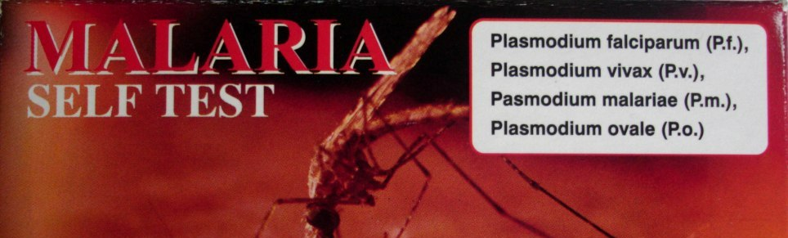
Types of parasites
Different RDTs can detect different types of malaria parasites.
The type of parasite is almost always printed on the packaging.
Abbreviations are very common.
Pf Pf and/and Pv
Pv Pf and/and Pan
Pan PF, Pv and/and Pan
Pf and Pv
A parasite is an organism that lives on or in another organism, the host, and gets its food from or at the expense of its host.
Parasites that cause malaria are of the genus Plasmodium

Slide 11
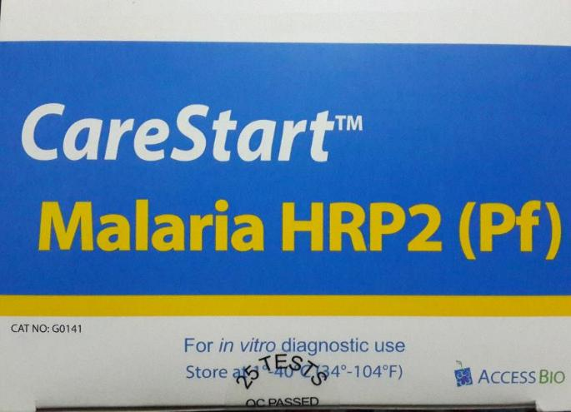
Type of parasite detected
Look for the different parasite species in this list:
Plasmodium falciparum (Pf)
Plasmodium vivax (Pv)
Plasmodium ovale (Po)
Plasmodium malariae (Pm)
All plasmodium species (Pan)
Vivax, Ovale, Malariae (vom/Pvom)
An RDT may test for more than one parasite, so be sure to select all that apply
Look for the abbreviations: "Pf/Pv Pan/Pf
Parasite specie(s): 1 Pf 2 Pf/Pan 4 Pf/Pv 5 Pan 8 Not indicated 96 Other; Specify: [_______________]

Slide 12
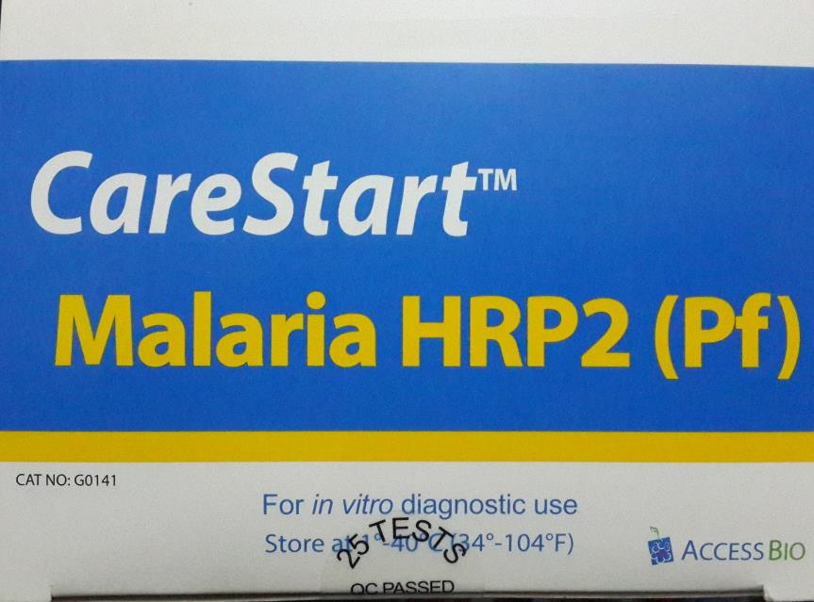
Antigen test
Antigen test(s): 1 HRP2 2 pLDH 3 HRP2/pLDH 4 HRP2/Aldolase 8 Not indicated 96 Other; Specify: [_______________________]
Look at what it says on the package.
Look for:
Histidine Rich Protein 2 (HRP2)
Plasmodium Lactate Dehydrogenase (pLDH)
Aldolase
An antigen binds to a specific antibody or T-cell receptor to trigger an immune response.
In less scientific terms, they are the alarm bells in your body that alert when there is a parasite or other foreign body.
When you have malaria, your body produces antigens, including HRP2 and/ or pLDH
RDTs test to see if you have these antigens in your blood.

Slide 13
ManufactureR and country of manufacture
Use the same indications you use for antimalarial drugs to identify.
Manufacture Name: Country:
Look for the logo or company name on the box
Look for the words:
“Manufactured by”
“Manufactured by”
“Under license from”
“Under license from”
Write the manufacturer's name in full
Look for country; be careful not to confuse the country of manufacture with :
Country of import
Distribution area

Slide 14
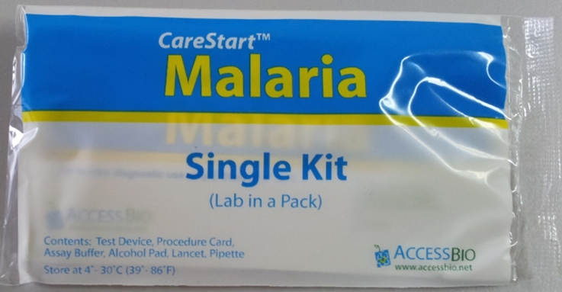
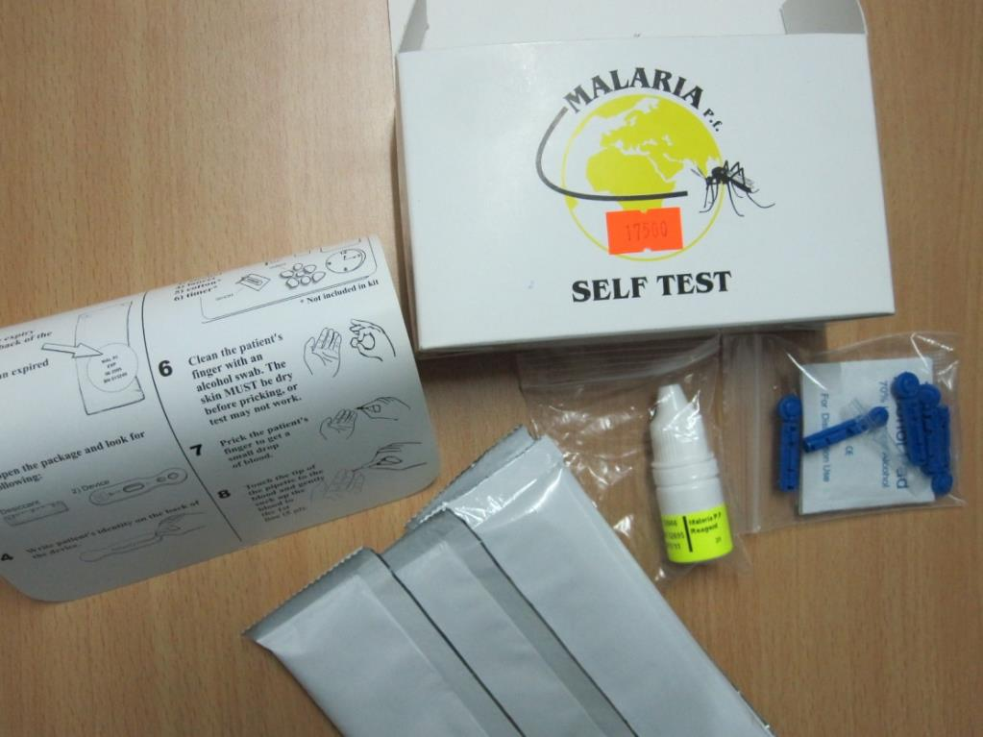

Is it a self-administration test kit with buffer, pipette and lancet?
Look for words like - "self test", "single kit".
Select “don’t know” if not indicated.

Slide 15
Quantity sold / distributed / used
How many tests have been sold or distributed in the last 7 days to individual customers (not wholesale)?
Quantity sold in the last 7 days : [___|___|___|___] [brand name] tests

Slide 16
Stock outs
When a sales outlet runs out of RDT, it is "out of stock".
We want to know if the product has ever been out of stock in the last 3 months.
Note:
Stockouts can be of any duration, long or short.
If it's a one-day or 3-week stockout, the correct answer is 1 = Yes.
Stocked out in last 3 months? 1 = Yes 0 = No 8 = Don’t know

Slide 17
Retail prices
We capture the price of an RDT test to consumers for each brand available at a given outlet.
You will capture the price for Adult and Child separately.
You will also capture the price to do the test “in-house” (at the outlet) and to “take-away.”
For in-house, capture the total cost= test price + consultation and any other fees.
Many outlets may not allow take-away testing.
In-house testing price to retail customers: Total cost for a test conducted with a [brand name] RDT (including RDT cost and service fee) for: Adult: [___|___|___|___|___]₦ to the last retail customer Child: [___|___|___|___|___]₦ to the last retail customer | Take-away testing price to retail customers: Total cost for a [brand name] RDT (including RDT cost and service fee) for: Adult: [___|___|___|___|___]₦ to the last retail customer Child: [___|___|___|___|___]₦ to the last retail customer

Slide 18
Purchase price FROM SUPPLIER
We want to know how much the outlet paid for this particular RDT from their supplier.
You will ask for the amount of this RDT that was purchased, then for the total amount of the order.
Price purchased from supplier: Price of last purchase of this product from your supplier Number of RDTs purchased: [___|___|___|___|___] Total price: [___|___|___|___|___]₦

Slide 19
Wholesale reSALE price
We ALSO want to know how much the outlet might sell this product to other outlets for re-sale.
Earlier in the interview you will determine if this outlet sells malaria products to other outlets.
If they do, you will ask for the minimum number of this RDT they sell at wholesale or for re-sale; then you will ask for the sale price for that amount of the product.
Wholesale price/ price for resale customers: Minimum wholesale/ resale amount and price [___|___|___|___] [brand] RDTs is the minimum amount sold by this outlet at wholesale or for resale and costs the outlets business customers [___|___|___|___|___]₦ for this quantity

Slide 20
Comments
Make a note of anything out of the ordinary that hasn't been mentioned in the previous questions.
For example:
The retail price for a RDT is less than the wholesale purchase price. When asked, the respondent said this was correct, as the tests are almost expired, they want to use them.
You may wish to note:
Retail prices lower than purchase price because RDT almost expired.

Slide 21
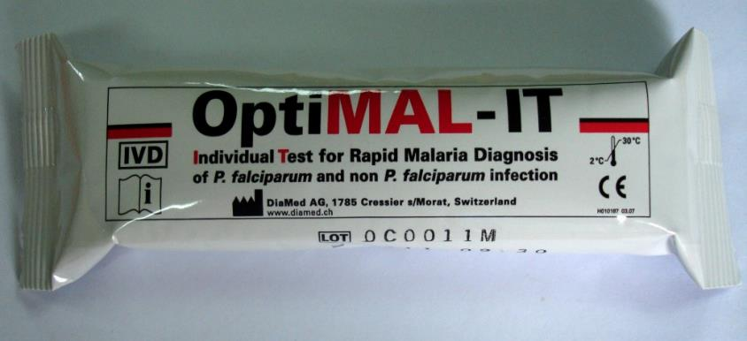
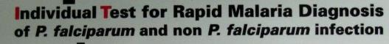
Parasite specie(s): 1 Pf 2 Pf/Pan 4 Pf/Pv 5 Pan 8 Not indicated 96 Other; Specify: [_ ]
non P. falciparum

Slide 22
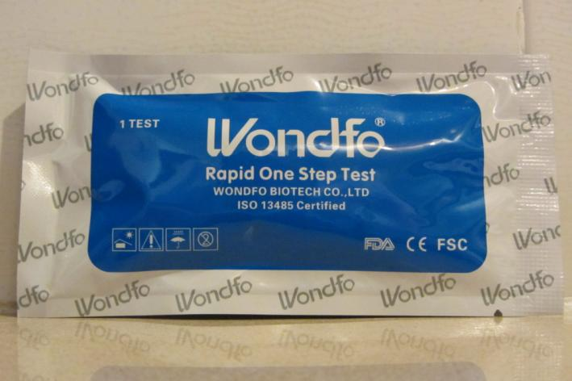
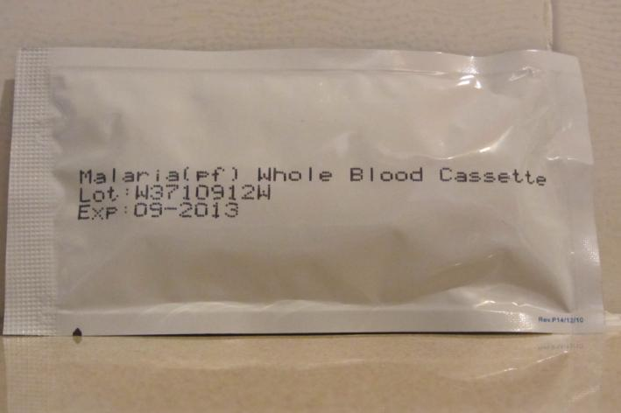
EXAMPLES FOR DISCUSSION
Brand name?
Antigen test?
Parasites?
Manufacturer?
Country of manufacture?

Slide 23
EXAMPLES FOR DISCUSSION
Brand name?
WONDFO RAPID ONE STEP TEST
Antigen test?
NOT INDICATED
Parasites?
PF
Manufacturer?
WONDFO BIOTECH CO LTD
Country of manufacture?
NOT INDICATED

Slide 24
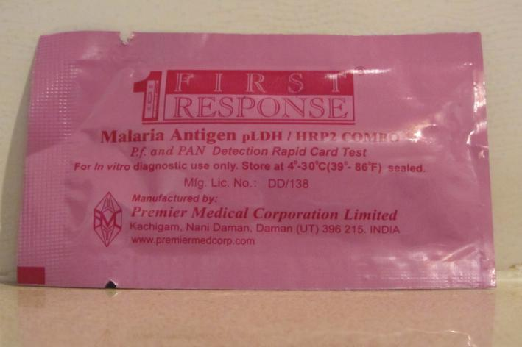
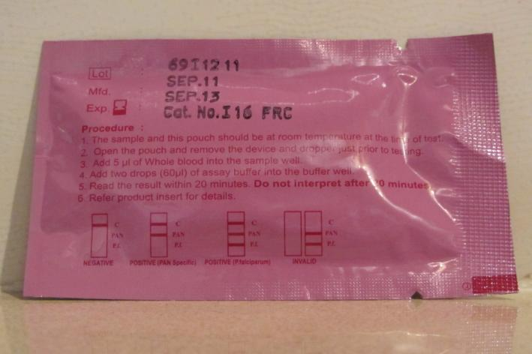
EXAMPLES FOR DISCUSSION
Brand name?
Antigen test?
Parasites?
Manufacturer?
Country of manufacture?

Slide 25
EXAMPLES FOR DISCUSSION
Brand name?
FIRST RESPONSE MALARIA ANTIGEN pLDH/HRP2 COMBO
Antigen test?
HRP2/ PLDH
Parasites?
PF/PAN
Manufacturer?
PREMIER MEDICAL CORPORATION LIMITED
Country of manufacture?
INDIA

Slide 26
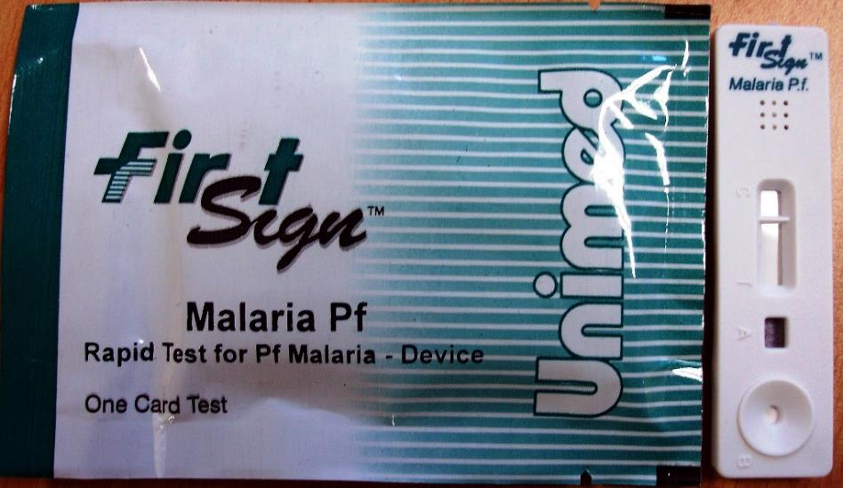
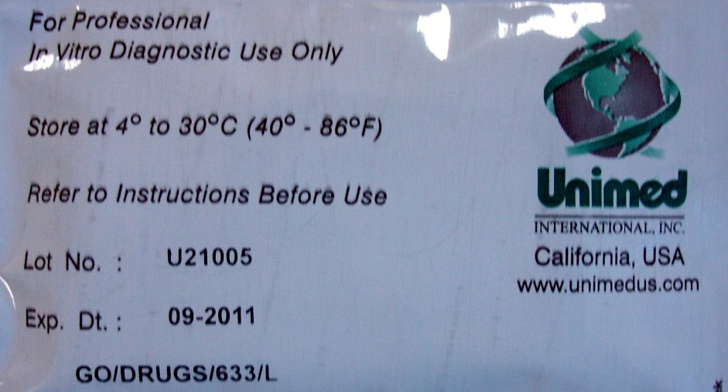
EXAMPLE 1
Brand name: | Parasite specie(s): 1 Pf 2 Pf/Pan 4 Pf/Pv 5 Pan 8 Not indicated 96 Other; Specify: [_______________] | Antigen test(s): 1 HRP2 2 pLDH 3 HRP2/pLDH 4 HRP2/Aldolase 8 Not indicated 96 Other; Specify: [_______________________] | Manufacture Name: Country:
FIRST SIGN MALARIA PF
UNIMED INTERNATIONAL
USA

Slide 27
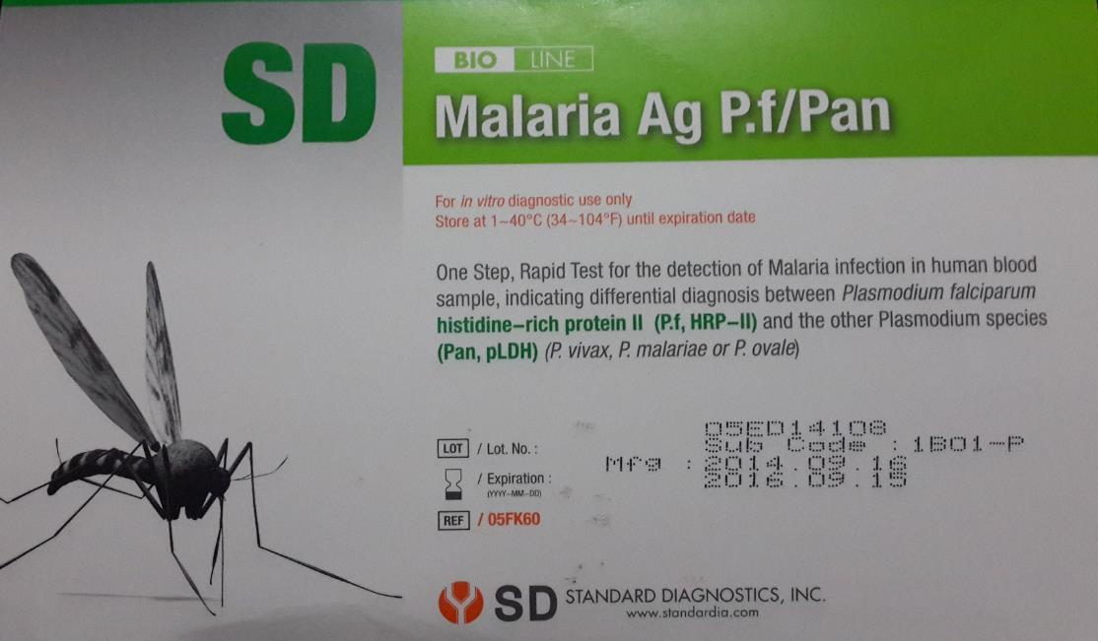
EXAMPLE 2
Brand name: | Parasite specie(s): 1 Pf 2 Pf/Pan 4 Pf/Pv 5 Pan 8 Not indicated 96 Other; Specify: [_______________] | Antigen test(s): 1 HRP2 2 pLDH 3 HRP2/pLDH 4 HRP2/Aldolase 8 Not indicated 96 Other; Specify: [_______________________] | Manufacture Name: Country:
2- PF/ PAN
STANDARD DIAGNOSTICS INC
SD BIOLINE MALARIA AG PF/PAN
3- HRP2
PLDH
9998

Slide 28

EXAMPLE 3
Brand name: | Parasite specie(s): 1 Pf 2 Pf/Pan 4 Pf/Pv 5 Pan 8 Not indicated 96 Other; Specify: [_______________] | Antigen test(s): 1 HRP2 2 pLDH 3 HRP2/pLDH 4 HRP2/Aldolase 8 Not indicated 96 Other; Specify: [_______________________] | Manufacture Name: Country:
MALARIA SELF TEST
ICT DIAGNOSTICS
SOUTH AFRICA
Pf; Pv; Pm; Po

Slide 29
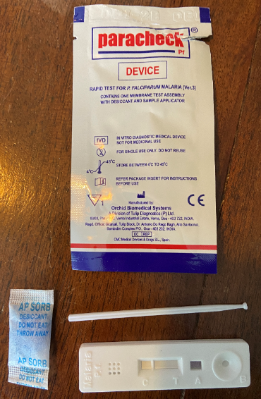
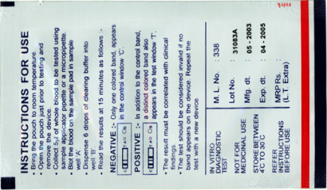
EXAMPLE 4
Brand name: | Parasite specie(s): 1 Pf 2 Pf/Pan 4 Pf/Pv 5 Pan 8 Not indicated 96 Other; Specify: [_______________] | Antigen test(s): 1 HRP2 2 pLDH 3 HRP2/pLDH 4 HRP2/Aldolase 8 Not indicated 96 Other; Specify: [_______________________] | Manufacture Name: Country:
ORCHID BIOMEDICAL
PARACHECK PF DEVICE
INDIA

Slide 30

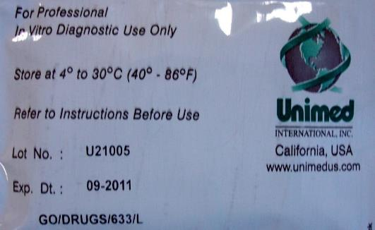
EXAMPLE
A provider in a private clinic says he has sold 4 tests in the last 7 days. What is the quantity sold / distributed or used in the last 7 days?
Quantity sold in the last 7 days : [___|___|___|___] [brand name] tests
Quantity sold in the last 7 days : [___4__] [brand name] tests

Slide 31
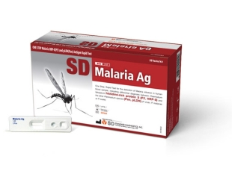
EXAMPLE
A provider in a large pharmacy says he has sold 10 boxes wholesale in for 100,000N and used 1 box of these RDTs to test patients in the last 7 days.
There are 25 tests in a box.
Note: Update price slides based on the currency of your country.
Quantity sold in the last 7 days : [___|___|___|___] [brand name] tests | Wholesale price/ price for resale customers: Minimum wholesale/ resale amount and price [___|___|___|___] [brand] RDTs is the minimum amount sold by this outlet at wholesale or for resale and costs the outlets business customers [___|___|___|___|___]₦ for this quantity
Quantity sold in the last 7 days : [___25___] [brand name] tests | Wholesale price/ price for resale customers: Minimum wholesale/ resale amount and price [___250___] [brand] RDTs is the minimum amount sold by this outlet at wholesale or for resale and costs the outlets business customers [___100,000__]₦ for this quantity

Slide 32
EXAMPLE
A private clinic provider says that this brand of RDT is used to test patients for malaria at the clinic.
In addition, he says, the cost of the RDT is 3000 ₦ for all patients. However, the patient must pay a fee of 1000 ₦ to receive the services of a RDT test.
What is the retail price for in-house testing?

Slide 33
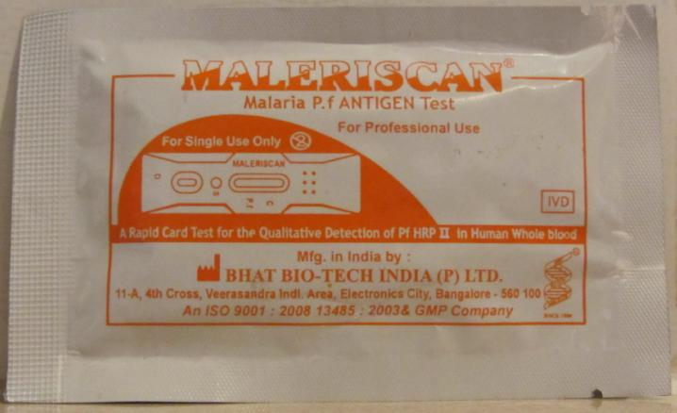
EXAMPLE
A lab technician at a local health center says they use this RDT free of charge to test all patients with a history of fever.
What is the total cost?

Slide 34
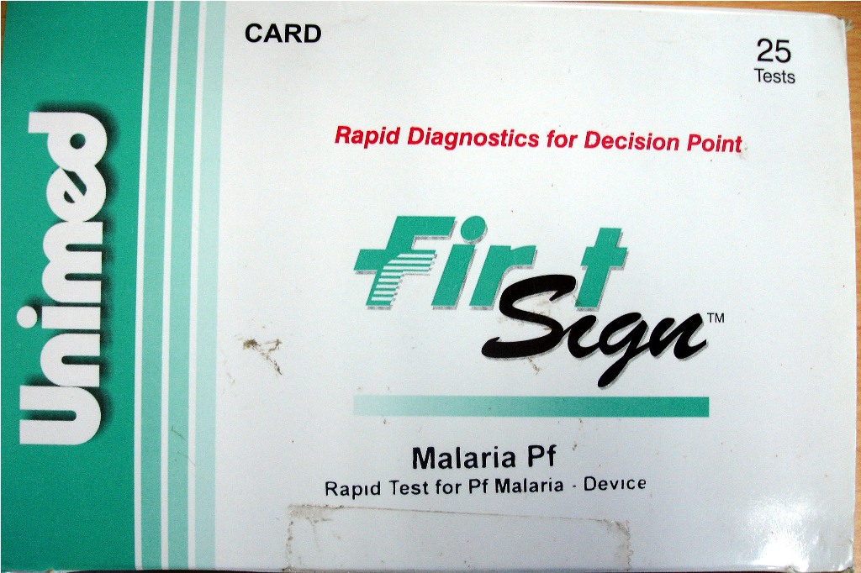
EXAMPLE
A respondent at a drug depot says they don't use this RDT to test patients in the outlet. But they do sell this RDT for 4000 ₦ to children under 5 and 5000 ₦ to adults.
What is the in-house cost?
What is the take-away cost?

Slide 35
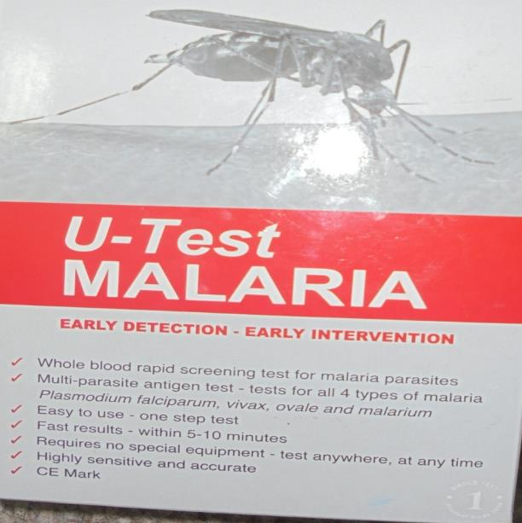
EXAMPLE
A respondent from a private clinic says that they provide on-site malaria testing using this RDT to all patients for 6000 ₦. The provider further says that there is a fixed price if you just want to buy the RDT kit, but they don't remember the price.
What is the in-house cost?
What is the take-away cost?
How will you record these prices?

Slide 36
EXAMPLE
A service provider in a large pharmacy says that his last wholesale purchase was 20 cartons of 25 tests, at a total cost of 300,000 ₦.
What was the wholesale purchase price?
Notes:
Answer: 500 tests for 300,000

Slide 37
EXAMPLE
A service provider in a large pharmacy says that his last wholesale purchase was 20 cartons of 25 tests, at a total cost of 300,000.
What was the wholesale purchase price?
The same retailer supplies other smaller outlets. He reports the minimum order requirement for this RDT from his pharmacy is 1 carton at a cost of 20,000.
What is the wholesale resale price?
Notes:
Answer: 25 tests for 20,000

Slide 38
You should now be able to … fill in the RDT audit form correctly
Recognize a rapid diagnostic test.
Complete all sections of the RDT audit form on paper.

Slide 39

Activity 6
This is a quick test to see what we have learnt:
The following slides have pictures of 3 different RDTs.
Complete an audit form for each RDT, using the information on the slide.
Do not discuss your answers – complete the form in silence.
We will mark your answers and give feedback (please put your name on each form, along with RDTs A, B, C, ...).
Aim: to assess progress and identify areas where the group needs more training (if any!).
Note for facilitators:
Use the images that follow the instructions on the next slide.
Give approx. 5 minutes per product.
The correct information is provided after the images.
Ask data collectors to complete “worksheet 6.”

Slide 40
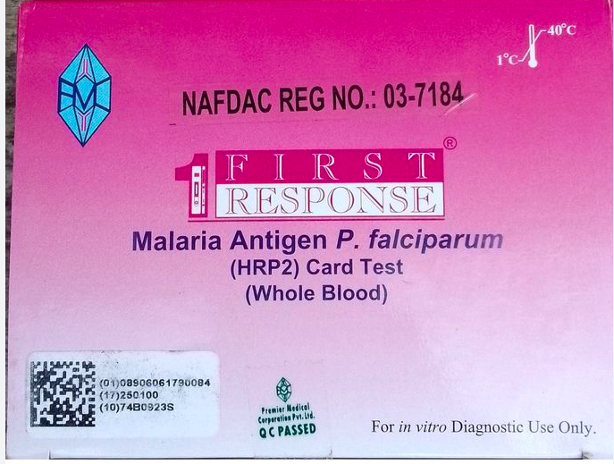
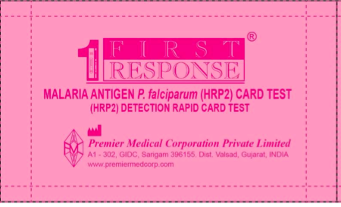
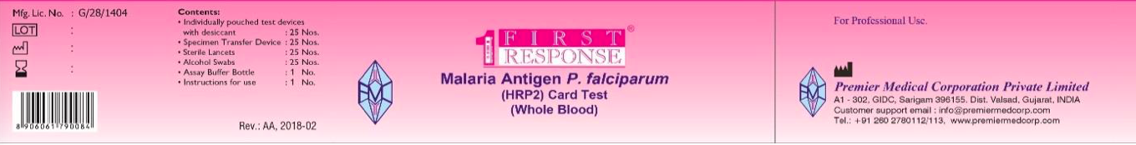
RDT A
Note: Update slides with the currency of your country.
The provider tells you:
Last week they sold 7 units of these, but usually they sell 2 per week.
Each one costs a customer 2,000XXX and the service was 500XXX for adult and free for kids.
There have been no stockouts.
They do not sell to other outlets
They refuse to tell you about their wholesale volume or prices.

Slide 41
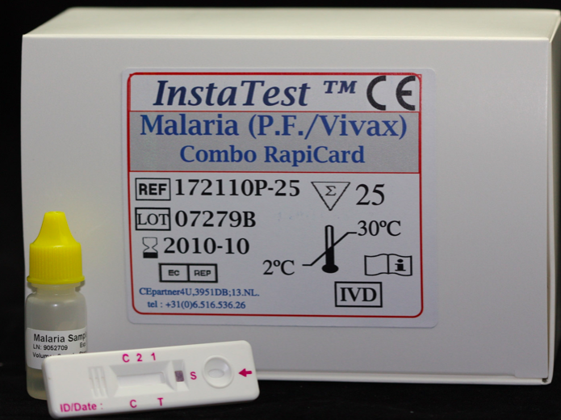
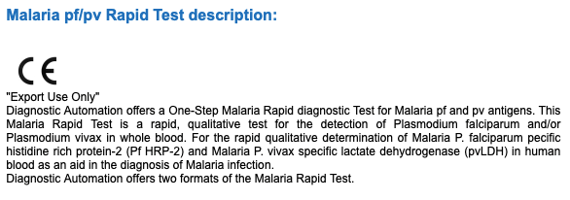
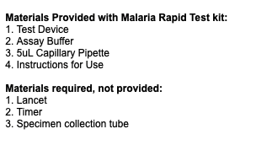
RDT B
Note: Update slides with the currency of your country.
The provider tells you:
Last week they sold 2 units of these.
Each one costs a customer 1,000XXX to take away. They do not do testing in this outlet.
They did not have them in stock in February.
They do not sell to other outlets.
They buy boxes of them wholesale for 9000XXX but don’t tell you how many they buy.

Slide 42
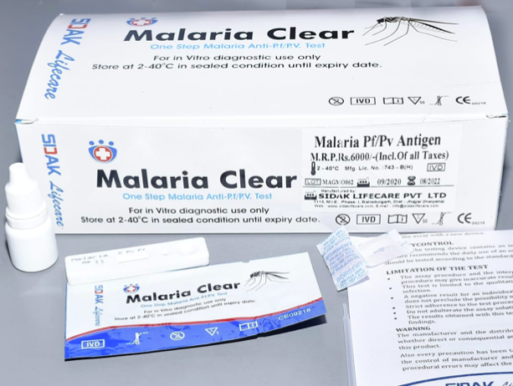
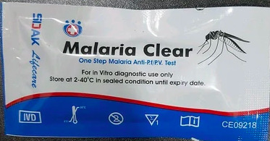
RDT C
Note: Update slides with the currency of your country.
The provider tells you:
Last week they sold 8 units of these.
Each one costs a customer 550XXX plus 1000XXX for the service.
They did not have them in stock in last week after selling all 8.
They do not sell to other outlets.
They buy boxes of them wholesale for 9000XXX but don’t tell you how many they buy.

Slide 43
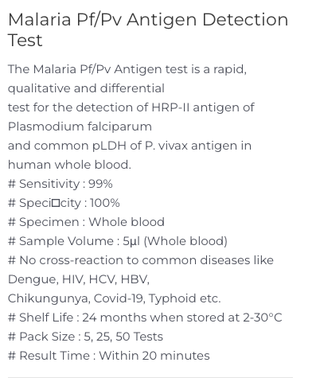
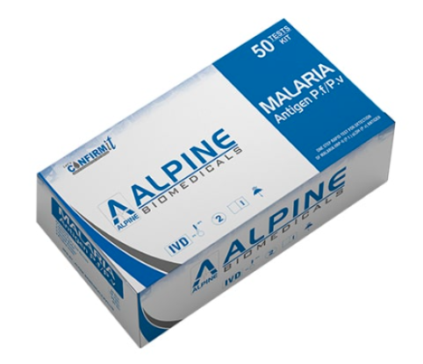
RDT D
Note: Update slides with the currency of your country.
The provider tells you:
Last week they sold 0 units of these.
Each one costs a customer 1500XXX to take away.
They are in stock.
They do sell to other outlets for 1400XXX per unit.
They refuse to tell you about wholesale.

Slide 44
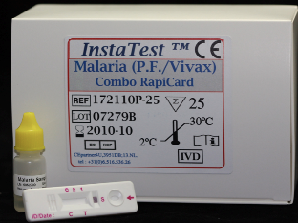
RDT A
ANSWERS
Note: Update slides with the currency of your country.
RDT B
Brand name: First Response
Parasite species: Pf
Antigen test: HRP2
Manufacturer name: Premier Medical Corporation Private Ltd
Manufacturer country: India
Self-administration: Not indicated, Don’t know
Quantity sold in the 7 days: 7
Stock out in the last 3 months: No
Retail prices: 2500XXX for in-house testing for adults and children ; No take away (n/a or don’t know)
Wholesale price: n/a
Purchase price from supplier: Refused
Brand name: Insta Test
Parasite species: Pf/Pv
Antigen test: HRP2
Manufacturer name: Not indicated, Don’t know
Manufacturer country: Not indicated, Don’t know
Self-administration: Yes
Quantity sold in the 7 days: 2
Stock out in the last 3 months: No (stock out was more then 3 mo. ago)
Inside testing price to retail customers for adult: N/A, they don’t do inside testing
Retail prices: No in-house testing (n/a); 1,000XXX take-away for adult and child
Wholesale price: n/a
Purchase price from supplier: Refused

Slide 45


ANSWERS
RDT C
RDT D
Brand name: Malaria Clear One Step Malaria Anti-Pf/Pv Test
Parasite species: Pf/Pv
Antigen test: NOT INDICATED
Manufacturer name: SIDAK LIFECARE PVT LTD
Manufacturer country: NOT LEGIBLE/ DON’T KNOW/ NOT INDICATED
Self-administration: YES
Quantity sold in the 7 days: 8
Stock out in the last 3 months: yes
Retail prices: 1550XXX for in-house testing for adults and children ; Not indicated or don’t know for take-away
Wholesale price: n/a
Purchase price from supplier: Refused
Brand name: Alpine Malaria Antigen P.f./P.v.
Parasite species: Pf/Pv
Antigen test: HRP2
Manufacturer name: Alpine Biomedicals
Manufacturer country: NOT LEGIBLE/ DON’T KNOW/ NOT INDICATED
Self-administration: Yes
Quantity sold in the 7 days: 0
Stock out in the last 3 months: no
Retail prices: 1500XXX for take away ; Not indicated or n/a for in-house
Wholesale price: 1400XXX
Purchase price from supplier: Refused

Slide 46
QUESTIONS?

